Slide 1
Motorbike inclination

Slide 2

Quick description

Slide 3
System design
ESP32
IMU
USER INTERFACE

Slide 4
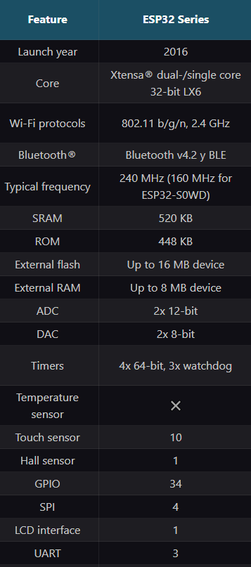
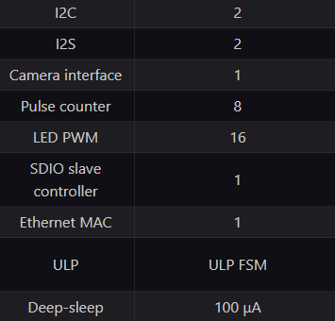
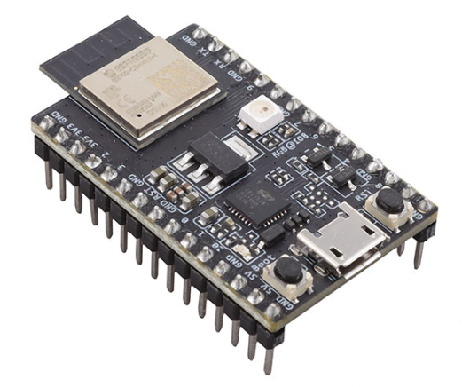
ESP32-WROOM-32S

Slide 5
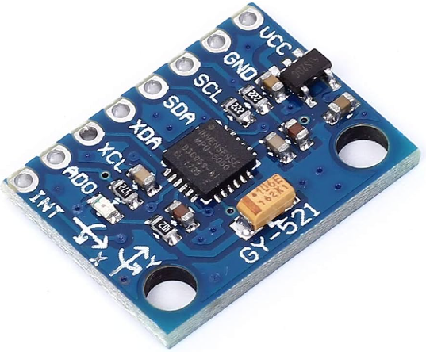
IMU MPU6050
PinOut
VCC - Power the sensor 3.3V
GND
SCL – clk for I2C
SDA – Data line for I2C
XDA – Used to interface other I2C with the MPU6050
XCL – Used to interface other I2C with the MPU6050
AD0 – Use this pin to change the I2C address
INT – Interrupt pin , can be used to indicate that new measurement data is available
This sensor contains an accelerometer and a gyroscope
Communication whit the module is through I2C

Slide 6
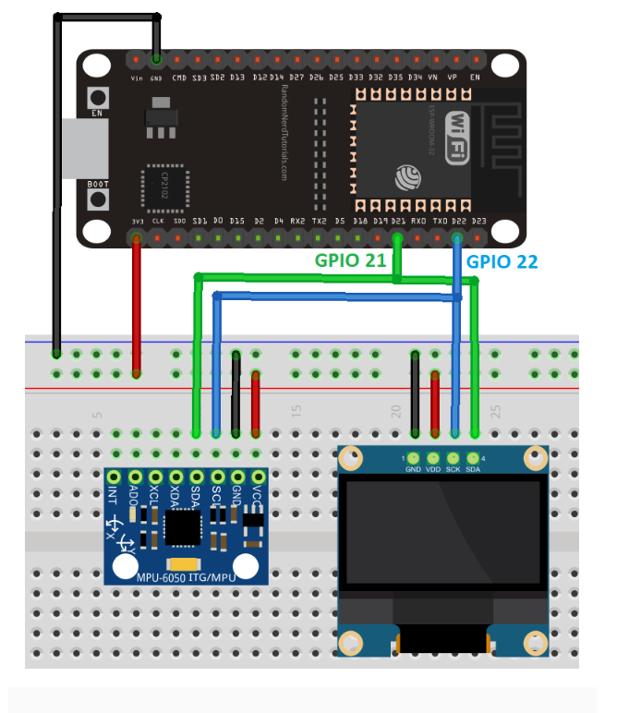
Connections

